Slide 1
Startup in IT
UNIT 4

Slide 2
A business plan is a formal statement of business goals, reasons how they are attainable, and plans for reaching them.

Slide 3
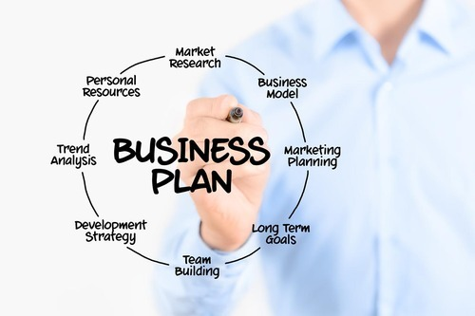
Planning of startup business

Slide 4

Benefits

Slide 5
Executive summary
Brief but comprehensive synopsis of a business plan or an investment proposal, which highlights its key points and is generally adapted for the external audience
Notes:
.

Slide 6
Executive summary
Write this section last.
make it two pages or fewer.
Include everything that you would cover in a five‐minute interview.
Explain the fundamentals of the proposed business:
-What will your product be?
-Who will your customers be?
-Who are the owners?
- What do you think the future holds for your business and your industry?
Make it enthusiastic, professional, complete, and concise.
Notes:
.

Slide 7
Executive summary
If applying for a loan:
state clearly how much you want
precisely how you are going to use it
how the money will make your business more profitable
Notes:
Executive summary
Brief but comprehensive synopsis of a business plan or an investment proposal, which highlights its key points and is generally adapted for the external audience.

Slide 8
General Company Description
This section provides a general direction of the business and outlines the company for potential investors or potential partners.
Notes:
General Company Description
This section provides a general direction of the business and outlines the company for potential investors or potential partners.

Slide 9
General Company Description
Mission Statement
Company Goals and Objectives
Business Philosophy
Target market
Describe your industry
Company strengths and core competencies.
Legal form of ownership
Notes:
General Company Description
This section provides a general direction of the business and outlines the company for potential investors or potential partners.

Slide 10
Products and Services
(technical specifications, drawings, photos, sales brochures, and other bulky items belong in Appendices).
What factors will give you competitive advantages or disadvantages? Examples include
level of quality or unique or proprietary features.
What are the pricing, fee, or leasing structures of your products or services?

Slide 11
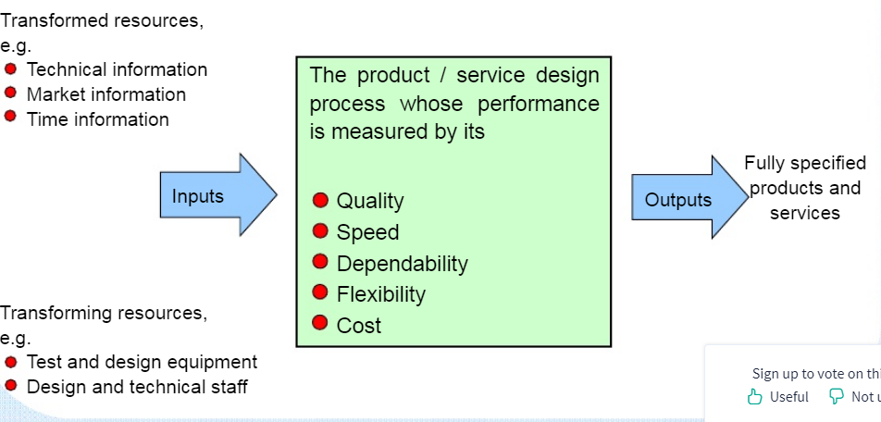
Products and Services

Slide 12
Marketing Plan
A marketing plan is a comprehensive document or blueprint that outlines a business advertising and marketing efforts for the coming year.

Slide 13
Marketing Plan
Market research - Why?
Market research - How?
Secondary research means using published information
Primary research means gathering your own data.
Give statistics, numbers, and sources.
Economics
Facts about your industry:
• What is the total size of your market?
• What percent share of the market will you have?
• Current demand in target market.
• Trends in target market
• Growth potential and opportunity for a business of your size.

Slide 14
Marketing Plan
• barriers
Some typical barriers are:
o High capital costs
o High production costs
o High marketing costs
o Consumer acceptance and brand recognition
o Training and skills
o Unique technology and patents
o Shipping costs
o Tariff barriers and quotas
• And of course, how will you overcome the barriers?
• How could the following affect your company?
o Change in technology
o Change in government regulations
o Change in the economy
o Change in your industry

Slide 15
Marketing Plan
Product
describe them from your customers’ point of view.
Features and Benefits
List all of your major products or services.
For each product or service:
• Describe the most important features. What is special about it?
• Describe the benefits. That is, what will the product do for the customer?
Customers
Identify your targeted customers, their characteristics, and their geographic location.
For each customer group, construct what is called a demographic profile:
Age
Gender

Slide 16
Marketing Plan
• Location
• Income level
• Social class and occupation
• Education
• Other (specific to your industry)
• Other (specific to your industry)
For business customers, the demographic factors might be:
• Industry (or portion of an industry)
• Location
• Size of firm
• Quality, technology, and price preferences
• Other (specific to your industry)
• Other (specific to your industry)
Competition
What products and companies will compete with you?
List your

Slide 17
Marketing Plan
Competition
What products and companies will compete with you?
List your major competitors:
Will they compete with you across the board, or just for certain products, certain customers, or in certain locations?
Will you have important indirect competitors?
How will your products or services compare with the competition?
Use the Competitive Analysis table below to compare your company

Slide 18
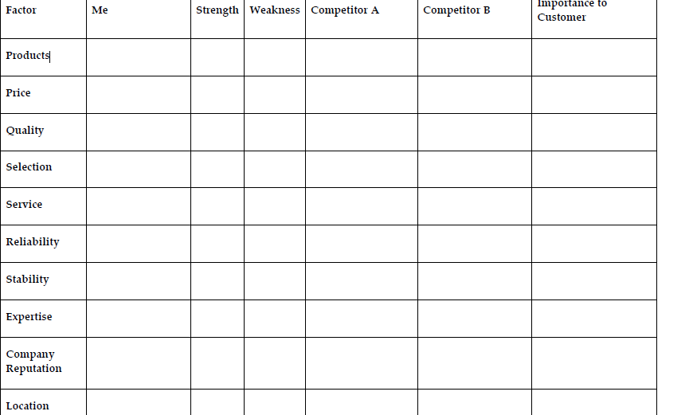
Marketing Plan
Competition
What products and companies will compete with you?
List your major competitors:
Will they compete with you across the board, or just for certain products, certain customers, or in certain locations?
Will you have important indirect competitors?
How will your products or services compare with the competition?
Use the Competitive Analysis table below to compare your company

Slide 19
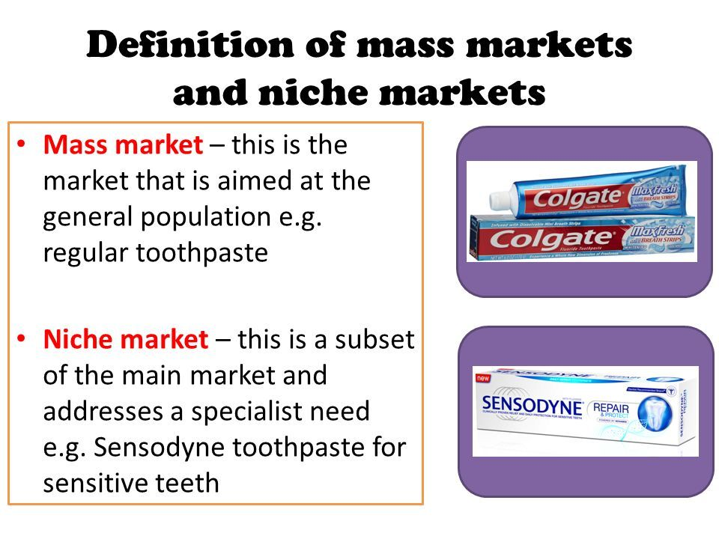
Marketing Plan

Slide 20
Marketing Plan
Strategy
Promotion
Promotional Budget
Pricing
Proposed Location
Distribution Channels
Sales Forecast
a ʺbest guessʺ, which is what you really expect,
a ʺworst caseʺ low estimate that you are confident you can reach no matter what happens.

Slide 21
Operational Plan
Explain the daily operation of the business, its location, equipment, people, processes,
and surrounding environment.
Production
• Production techniques and costs
• Quality control
• Customer service
• Inventory control
• Product development
Location
Physical requirements:
• Amount of space
• Type of building
• Zoning
• Power and other utilities

Slide 22
Operational Plan
An Operational Plan is a highly detailed plan that provides a clear picture of how a team, section or department will contribute to the achievement of the organisation's goals.

Slide 23
Operational Plan
Access:
Is it important that your location be convenient to transportation or to suppliers?
Do you need easy walk‐in access?
What are your requirements for parking and proximity to freeway, airports, railroads, and shipping centers?
Include a drawing or layout of your proposed facility if it is important, as it might be for
a manufacturer.
Construction
Cost
Legal Environment
Describe the following:
• Licensing and bonding requirements
• Permits
• Health, workplace, or environmental regulations

Slide 24
Operational Plan
• Special regulations covering your industry or profession
• Zoning or building code requirements
• Insurance coverage
• Trademarks, copyrights, or patents (pending, existing, or purchased)
Personnel
• Number of employees
• Type of labor (skilled, unskilled, and professional)
• Where and how will you find the right employees?
• Quality of existing staff
• Pay structure
• Training methods and requirements
• Who does which tasks?
• Do you have schedules and written procedures prepared?
• Have you drafted job descriptions for employees? If not, take time to write some.
They really help internal communications with employees.

Slide 25
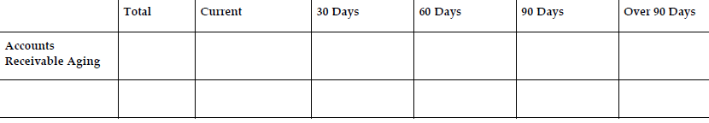
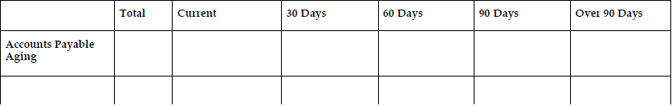
Operational Plan
• For certain functions, will you use contract workers in addition to employees?
Inventory
Suppliers
Credit Policies
Managing Your Accounts Receivable
Managing Your Accounts Payable

Slide 26
Management and Organization
Who will manage the business on a day‐to‐day basis?
What experience does that person bring to the business?
What special or distinctive competencies?
Is there a plan for continuation of the business if this person is lost or incapacitated?
If you’ll have more than 10 employees, create an organizational chart showing the
management hierarchy and who is responsible for key functions.
Include position descriptions for key employees.
Professional and Advisory Support
List the following:
• Board of directors
• Management advisory board
• Attorney
• Accountant
• Insurance agent
• Banker
• Consultant or consultants
• Mentors and key advisors

Slide 27
Personal Financial Statement
A personal financial statement is a document or spreadsheet outlining an individual's financial position at a given point in time.

Slide 28
Personal Financial Statement
for each owner and major stockholder, showing assets and liabilities held outside the business and personal net worth.
Owners will often have to draw on personal assets to finance the business
These statements will show what is available.
Bankers and investors usually want this information as well.

Slide 29
Startup Expenses and Capitalization
The startup expenses represents a list of individual items.
capitalization represents the total required investment .
between 1-2 pages in length.
The purpose is to inform the reader of all the resources your company requires will require to initiate it’s operating.
The total cost of the resources you plan to leverage represents the required capitalization to launch your business.
Entrepreneurs should very plainly list all of their:
-startup expenses
-their associated costs
Including brief explanations for unusual items and/or capital intensive or expensive items should be considered.

Slide 30
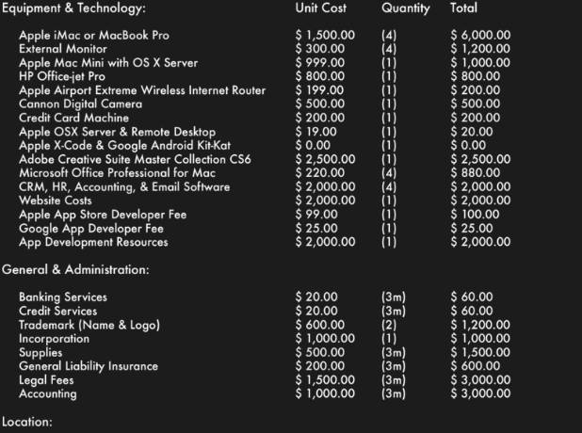
Startup Expenses and Capitalization

Slide 31
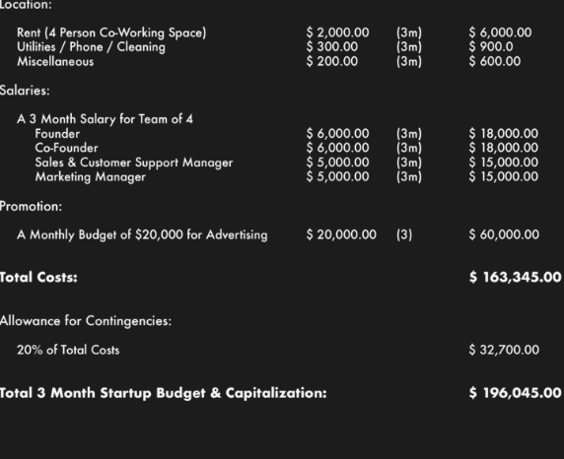
Startup Expenses and Capitalization

Slide 32
Financial Plan
Financial planning is the task of determining how a business will afford to achieve its strategic goals and objectives.
Notes:
Break-Even Analysis Expressed as a formula, break‐even is:
Break‐Even Sales = Fixed Costs
1‐ Variable Costs
(Where fixed costs are expressed in dollars, but variable costs are expressed as a percent
of total sales.)
Include all assumptions upon which your break‐even calculation is based.

Slide 33
Financial Plan
Within this section entrepreneurs are expected to include a number of financial statements;
A. 12 Month Profit & Loss Statement
This is where you put it all together in numbers and get an idea of what it will take to make a profit and be successful.
B. Three-Year Profit Projection (Optional)
The 12‐month projection is the heart of your financial plan. The Three‐Year Profit projection is for those who want to carry their forecasts beyond the first year.
C. Projected Cash Flow
The point of this worksheet is to plan how much you need before startup, for preliminary expenses, operating expenses, and reserves.
For each item, determine when you actually expect to receive cash (for sales) or when
you will actually have to write a check (for expense items).
Opening Day Balance Sheet
A balance sheet is one of the fundamental financial reports that any business needs for reporting and financial management.
Break-Even Analysis
it’s the sales level that is the dividing line between operating at a loss and operating at a profit.
Notes:
Break-Even Analysis Expressed as a formula, break‐even is:
Break‐Even Sales = Fixed Costs
1‐ Variable Costs
(Where fixed costs are expressed in dollars, but variable costs are expressed as a percent
of total sales.)
Include all assumptions upon which your break‐even calculation is based.

Slide 34
APPENDICES
The appendices contain letters and charts with important data that not only support the book's arguments, but also open new ways for future investigations.

Slide 35
APPENDICES
Include details and studies used in your business plan; for example:
• Brochures and advertising materials
• Industry studies
• Blueprints and plans
• Maps and photos of location
• Magazine or other articles
• Detailed lists of equipment owned or to be purchased
• Copies of leases and contracts
• Letters of support from future customers
• Any other materials needed to support the assumptions in this plan
• Market research studies
• List of assets available as collateral for a loan

Slide 36
Refining the Plan
The generic business plan presented above should be modified to suit your specific type of business and the audience for which the plan is written

Slide 37
Refining the Plan
For Raising Capital
For Bankers
Bankers want assurance of orderly repayment. If you intend using this plan to present to lenders, include:
o Amount of loan
o How the funds will be used
o What this will accomplish—how will it make the business stronger?
o Requested repayment terms (number of years to repay).
Collateral offered, and a list of all existing liens against collateral

Slide 38
Refining the Plan
For Investors
Investors have a different perspective. They are looking for dramatic growth, and they expect to share in the rewards:
o Funds needed short‐term
o Funds needed in two to five years
o How the company will use the funds, and what this will accomplish for
growth.
o Estimated return on investment
o Exit strategy for investors (buyback, sale, or IPO)
o Percent of ownership that you will give up to investors
o Milestones or conditions that you will accept
o Financial reporting to be provided
o Involvement of investors on the board or in management

Slide 39
Refining the Plan
For Type of Business
Manufacturing
• Planned production levels
• Anticipated levels of direct production costs and indirect (overhead) costs—how do these compare to industry averages (if available)?
• Prices per product line
• Gross profit margin, overall and for each product line
• Production/capacity limits of planned physical plant
• Production/capacity limits of equipment
• Purchasing and inventory management procedures
• New products under development or anticipated to come online after startup

Slide 40
Refining the Plan
Service Businesses
Service businesses sell intangible products. They are usually more flexible than other types of businesses, but they also have higher labor costs and generally
very little in fixed assets.
• What are the key competitive factors in this industry?
• Your prices
• Methods used to set prices
• System of production management
• Quality control procedures. Standard or accepted industry quality standards.
• How will you measure labor productivity?
• Percent of work subcontracted to other firms. Will you make a profit on subcontracting?
• Credit, payment, and collections policies and procedures
• Strategy for keeping client base

Slide 41
Refining the Plan
High Technology Companies
• Economic outlook for the industry
• Will the company have information systems in place to manage rapidly changing
prices, costs, and markets?
• Will you be on the cutting edge with your products and services?
• What is the status of research and development? And what is required to:
o Bring product/service to market?
o Keep the company competitive?
• How does the company:
o Protect intellectual property?
o Avoid technological obsolescence?
o Supply necessary capital?
o Retain key personnel?

Slide 42
Refining the Plan
High‐tech companies sometimes have to operate for a long time without profits and sometimes even without sales.
If this fits your situation, a banker probably will not want to lend to you. Venture capitalists may invest, but your story must be very good.
You must do longer‐term financial forecasts to show when profit take‐off is expected to occur.
Your assumptions must be well documented and well argued.
Retail Business
• Company image
• Pricing:
o Explain markup policies.
o Prices should be profitable, competitive, and in accordance with company image.

Slide 43
Refining the Plan
• Inventory:
o Selection and price should be consistent with company image.
o Inventory level.
• Customer service policies:
These should be competitive and in accord with company image.
• Location: Does it give the exposure that you need? Is it convenient for
customers? Is it consistent with company image?
• Promotion: Methods used, cost. Does it project a consistent company image?
• Credit: Do you extend credit to customers? If yes, do you really need to, and do you factor the cost into prices?

Slide 44

STARTUP STORY
FLIPKART
HISTORY
Back in 2007, when Flip kart was launched, Indian e-commerce industry was taking its beginner steps. The company is registered in Singapore, but their headquarters are in the city of Bangalore, India.

Slide 45
Founders
Sachin Bansal and Binny Bansal, who were working for Amazon.com had an idea to start an e-commerce company in India. Both of them are alumni of IIT, Delhi and are native of Chandigarh, India. They left their jobs in Amazon to start their own business.

Slide 46
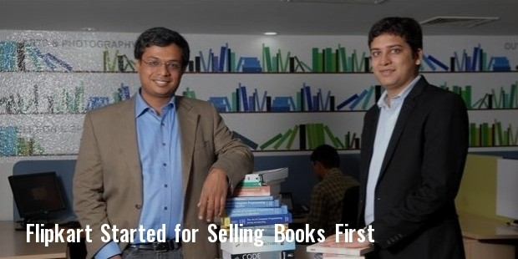
How it Started?
Flipkart began selling books to begin with. It soon expanded and began offering a wide variety of goods

Slide 47
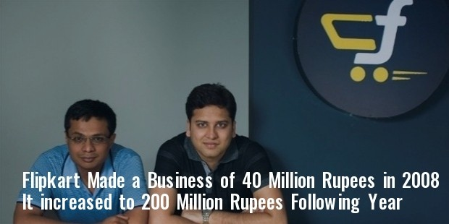
Funding History
This soon increased to 200 million Indian rupees the following year. Their last round of Fundraising had increased their value to $ 15 billion.

Slide 48
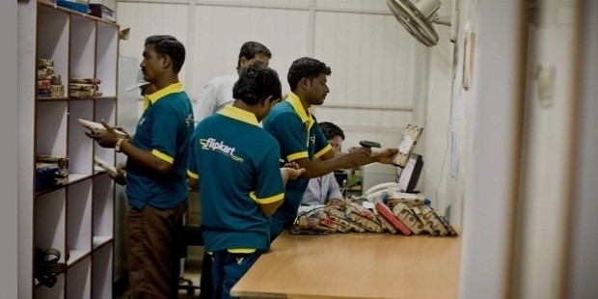
Evolution
the problem of online payment gateways. Not many people preferred online payment and the gateways were not easy to set up. Flip kart tackled this problem by introducing cash on delivery and payment by card on delivery in addition to others. Flipkart was the first to implement the popular ‘Cash On Delivery’ facility, which every online shopping website in India offers as an option today.

Slide 49
Evolution
The second problem was the entire supply chain system. Delivering goods on time is one of the most important factor that determines the success of an ecommerce company. Flipkart addressed this issue by launching their own supply chain management system to deliver orders in a timely fashion.

Slide 50
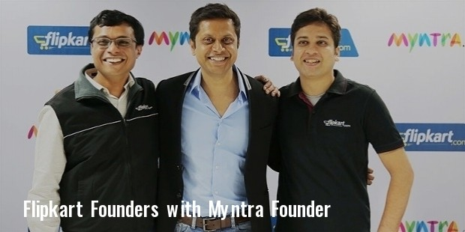
Acquisitions
Flipkart also acquired few companies like Myntra.com, LetsBuy.com etc., to better their presence in the market. Flipkart’s journey from a small book e-retailer to India’s largest e-commerce platform inspires a generation of start-ups.
In a country where stereotypes are common, Flipkart managed to break the norm and change the ecommerce industry in India for ever.

Slide 51

STARTUP STORY
Make My Trip
FOUNDER
Deep Kalra is the proud founder of Gurgaon based – MakeMyTrip.com.
Speaking of his qualification; Deep holds a Bachelor’s degree in Economics from the St. Stephen’s College, Delhi, after which he went on to pursue his Masters in Business Administration degree from the Indian Institute of Management, Ahmedabad (IIM-A).

Slide 52
STARTUP STORY
Make My Trip
FOUNDER
How did his journey begin?
Deep’s career started soon after he completed his Masters with IIM-A & went on to work for companies like GE Capital, ABN AMRO Bank, etc!
Now back in 1995, Deep Kalra took a huge risk by quitting his stable & good-paying but boring job at ABN Bank to join AMF Bowling – an American company that was hoping to enter the Indian market to setup bowling alleys and billiard halls.

Slide 53
STARTUP STORY
Make My Trip
FOUNDER
How did his journey begin?
He put in all that he had and managed to open more than 200 lanes, most of them in small centres. What was even worse was that, the venture wasn’t really his own thing, and he had a remote boss back in America who threw him in the market without giving him the appropriate mentorship or guidance.

Slide 54
STARTUP STORY
Make My Trip
FOUNDER
How did his journey begin?
Evidently, for obvious reasons this did not appeal to him and he also realized that they were all not worth his talent. He needed something more to showcase the same!

Slide 55
STARTUP STORY
Make My Trip
FOUNDER
How did his journey begin?
At the same time, he noticed that the Internet industry was growing at the speed of fire and held a lot that could be capitalized on! Having said that, he quit his job & began the old-age brain storming session! He saw that, with all the brokers, the agents & middlemen in place, the online travel booking industry was messier than a man’s bedroom!

Slide 56
STARTUP STORY
Make My Trip
FOUNDER
How did his journey begin?
Hence, with a backing of USD 2-Million from eVentures and along with co-founders like – Keyur Joshi, Rajesh Magow and Sachin Bhatia, deep began his new found journey with MakeMyTrip.com (earlier known as India Ahoy) in 2000.

Slide 57
STARTUP STORY
Make My Trip
Phase I – Rough Start
Initially, he had also seen that the Indian market was yet to evolve & mature, when it came to the internet industry and playing it safe seemed far more viable than otherwise! Hence, he started off by catering to the overseas Indian community for their US-to-India travel needs.
Anyways just within two years from their launch, their business got jinxed and the dot com market crashed, taking down everything they had begun to make!
This was a very hard time for them and literally everyone who belonged to the internet market. VC’s weren’t ready to touch the internet industry. Their VC, who once ready to offer any hefty capital they demanded, now wasn’t even ready to give USD 1-million.
The situation was so bad that in-order to save the company, Deep had to take some very harsh decisions. They had to reduce their employee strength by a literal half, and what was even worse was that, he also had to let go of their & few other top-management employee’s salaries for the next 18-months.

Slide 58
STARTUP STORY
Make My Trip
Phase II – Steady Rise
Taking some thoughtful, stern yet intelligent decisions, MakeMyTrip turned out to be one of those few who managed to survive the tsunami. And as time passed, the situation got better and their decision turned out to be fruitful as well.
Their business now had begun to pick up & was reaching a decent customer base. That is when IRCTC (Indian Railways Catering and Tourism Corporation) launched their first online business model which enabled the Indian traveller to purchase railway tickets on the Internet.
This model of IRCTC was well accepted but the Indian masses and turned out to be a huge hit. Additionally, Low-Cost Carriers had also recently entered the Indian Aviation space. These chains of events opened a whole new level of opportunities for the travel market in India.
It was now time to broaden their portfolio and although this venture for the Indian market was too ahead of time for various reasons like using their credit cards online, trust issues for non-established brands, etc. they risked it anyway.
And in September 2005, they officially launched their services for the Indian market as well.
As a first; apart from flight ticketing MakeMyTrip began by offering holiday packages and hotel bookings which was followed by their tie-up with IRCTC’s online business model.

Slide 59
STARTUP STORY
Make My Trip
Phase II – Steady Rise
This move not only increased their presence in railway ticket booking but also gave the much desired boost the Indian market was looking for!
And in a matter of no time, the company started making awesome revenues. The demand was so much that 1-out-of-every-12 domestic flights in India were booked through MakeMyTrip.
Within a year, the company had acquired 200,000 happy customers. As a matter of fact, when the world was in recession in 2008, the company was crossing their Rs1000-Cr mark.
The same year the company also recorded profits worth $5-million with gross revenues being approx $500-million.

Slide 60
STARTUP STORY
Make My Trip
Phase II – Steady Rise
From here onwards, the company brought about a lot of additions to its existing profile; be it launching a multi-city flight booking service “Alootechie.com,” adding chauffeur-driven online cab rental services or creating several travel-related Apps for all types of mobile devices, they made sure to leave no table unturned.
But the biggest news that came to light was their listing on NASDAQ, in August 2010!
This was like the ultimate blow for all its potential competitors. As satisfying and happy the moment was for them, it was equally a proud moment for India too, because MakeMyTrip was one of the very few Indian Dotcom companies to be listed on the US stock exchange.
This also bridged the gap between the foreign investors & Indian businesses; thus opening doors for a pool of foreign investments in India in the IT sector. Additionally, this also boosted the confidence of the young entrepreneurs which gave rise to a lot of start-ups in the future.
Since then, MakeMyTrip has majorly focused on expansion and up-ping the revenue which has been done through various mediums such as unique marketing strategies, product development, etc!

Slide 61
STARTUP STORY
Make My Trip
Phase III – Wide Expansion
During this phase of expansion; even though the company faced their share of problems, but at the same time they also managed to rise out of it bravely and used these hurdles to expand their reach far beyond their imaginations! These comebacks have also time-&-again been proved through their numbers.
One such problem they faced was in December 2013; the wealth of MakeMyTrip which was over $50-mil had been cut by halve & their net revenues declined 5.5% as well. MakeMyTrip was also seen to be booking losses worth $2.6-million.
Times were hard for them but as they had faced problems earlier, they were more prepared and experienced to tackle issues this time, and hence in the next quarter, MakeMyTrip successfully came back with a bang & proved themselves by reporting a 27.7% rise in revenues.

Slide 62
STARTUP STORY
If that wasn’t enough then in march 2014, MakeMyTrip announced a $15 million innovation fund for new entrepreneurs in the travel circuit. And when we looked at the recent stats of the NASDAQ listed company; with a current market cap of $934-Million they seem to be growing drastically too.
And lastly; apart from initial investment of 2-million, MakeMyTrip has raised USD 10-million in 2005, USD 13-million in 2006 & USD 15-million in 2007 from investors such as SAIF (Softbank Asia Infrastructure Fund) Partners, Helion Venture Partners, Sierra Ventures & Tiger Global, till date!

Slide 63
STARTUP STORY
Phase IV – Mergers, Acquisitions & Investments
Over the period of time, MakeMyTrip has also done some notable mergers, acquisitions & Investments, some of these include: –
MyGola – A start-up travel guide firm was acquired by MakeMyTrip for an undisclosed amount in April 2015
com – A Gurgaon based online health store received investment worth $6 million from Deep Kalra along with other investors such as Sequoia Capital, Omidyar Network, Intel Capital and Kae capital April 2015.
TrulyMadly – Deep Kalra also made angel investments in the matchmaking website in March 2015.
com (ETB) – An online hotel operator based in Amsterdam was recently acquired by MakeMyTrip in February 2014.

Slide 64
STARTUP STORY
Hotel Travel Group (HT Group) – Again a Travel firm with operations in Thailand, Singapore and Malaysia was acquired in November 2012
ITC Group – A Tour operating company based in Thailand was acquired in November 2012
My Guest House Accommodation – A Budget Lodging / Hotel Operator based in Delhi was acquired in November 2011
Le Travenues Technology Private Limited – The Parent company of Ixigo.com based in Gurgaon, which performs ‘online travel meta search engine’ was acquired by MakeMyTrip in August 2011.
Luxury Tours and Travel Private Limited – A Singapore based Travel Agency was acquired by MakeMyTrip in May 2011.

Slide 65
STARTUP STORY
Achievements
Chairperson of the NASSCOM Internet Working Group
Member of the Executive Council of NASSCOM
Member of CII’s Tourism sub-committee
Awarded as the “Best Travel Portal India” by World Travel Awards (2014, 2013)
Awarded as the “E-tailer of the Year” by ET Retail Awards (2014, 2013)
Awarded as the “Best Online Travel Service Firm” by Times Travel Honours (2011)
Listed as “Ten Best Companies to Work For in India” by Great Place to Work Institute (2013, 2012, 2011, 2010)

